Slide 1
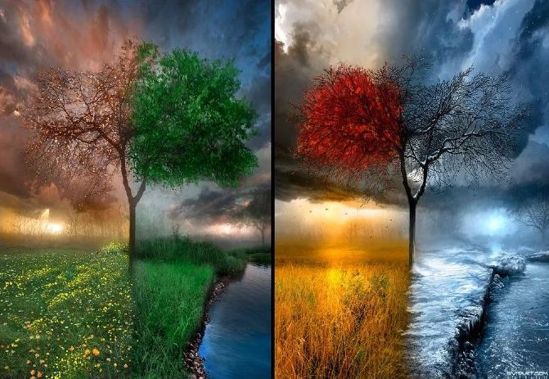
Конспект урока в 5 классе: «Year after year»
Подготовила:
Васильчук Анастасия Владимировна,
учитель английского языка
МБОУ «Владиславовская ОШ»

Slide 2
Aims
To read and talk about the weather, seasons;
Learn to describe the weather;
To repeat the Present Simple and Present Continuous;
Reading, writing, listening and speaking
English at the lesson.

Slide 3
Mark «3»
Translate to Russian
Month
Magazine
Autumn
Season
Spring
Weather forecast
Year
It’s very hot
It’s freezing
It’s snowing
Translate into English
Mark «4»
11. Лето
12. Январь
13. Тепло
14. Холодно
15. Сентябрь
Mark «5»
16. Собирать цветы
17. Погода
18. Светит солнце
19. Ходить купаться
20. Идет дождь

Slide 4
Оценка «3»
Месяц
Журнал
Осень
Время года
Весна
Прогноз погоды
Год
Очень жарко
Морозно
Идет снег
Оценка «4»
11. Summer
12. January
13. It’s warm
14. It’s cold
15. September
Оценка «5»
16. Pick flowers
17. Weather
18. The sun is shining
19. Go swimming
20. It’s raining

Slide 5
Weather
Weather is hot, Weather is cold, Weather is changing As the weeks unfold.
Skies are cloudy, Skies are fair, Skies are changing In the air.
It is raining, It is snowing, It is windy With breezes blowing.
Days are foggy, Days are clear, Weather is changing Throughout the year!

Slide 6
Phonetic station

Slide 7
Phonetic station
Read and translate
[si:zn] [wind] [skeit]
[rein] [gri:n ] [swim]
[tri:] [plei] [best]
[red] [melt] [dei]
[wet] [windi] [ski:]

Slide 8
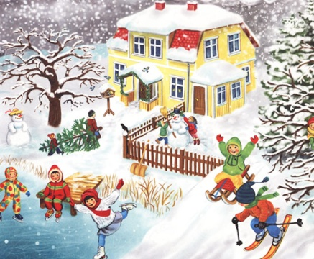
Work in the book
Ex. 1, p. 86
*Ex.2, p. 86 (b)

Slide 9
What is the weather like in different seasons?
Frosty
Snowy
Hot
Cool
Warm
Cold
Foggy
Sunny
Cloudy
Slippery
Fine
Windy
Wet
Rainy

Slide 10
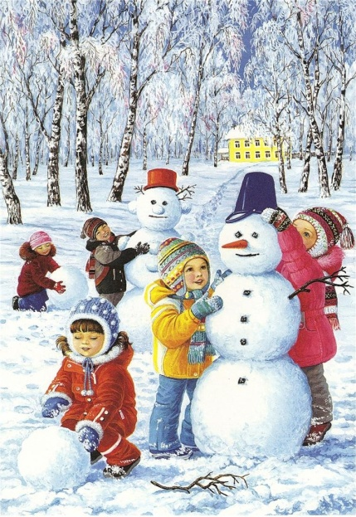
How many children are there?
How many boys are there and how many girls?
What are you doing?
What season is it? Etc.
(Ex. 3, p. 86)
Describe pictures
Work on cards

Slide 11
Read the text
Ex. 4, p. 87
Ex. 5, p. 87
Answer the questions.
1. What is the weather like in Scotland now?
2. What is Gus doing in Scotland?
3. Where is it snowing?
4. What season is it in Australia?

Slide 12
Let’s have a rest…

Slide 13
Speaking
What’s the weather like in Scotland, Switzerland, Australia? Make notes, then tell the class.
Scotland | Switzerland | Australia

Slide 14
Present Simple and Present Continuous

Slide 15
Present Continuous

Slide 16
Present Simple
Утверждение Отрицание Вопрос
I work I do not work Do I work ?
You work You do not work Do you work ?
He works He does not work Does he work?
She works She does not work Does she work?
It works It does not work Does it work ?
We work We do not work Does we work ?
You work You do not work Do you work ?
They work They do not work Do they work ?

Slide 17
Fill in the gaps (Present Continuous) and Make of it Present Simple
1. The child … (sleep) now.
2. My sisters … (cry), I don’t know what to do.
3. What … you (do) tonight?
4. Look! He … (swim) so well. He will be a winner.
5. I … (go) to call my sister. She … (travel) around the world now.

Slide 18
Everyday English What`s the weather like today?
Negatively
It`s awful!
It`s terrible!
It`s freezing!
It`s cold!
Positively
It`s a lovely day!
It`s warm!
It`s very hot!
It`s fabulous!

Slide 19
The weather
It`s sunny. The sun is shining. It`s hot/warm.
It`s cloudy.
It`s raining. It`s windy.
It`s snowing. It`s cold. It`s freezing.

Slide 20
Summarizing
What have you learned about weather, seasons?
Did you like the lesson?
Marks

Slide 21
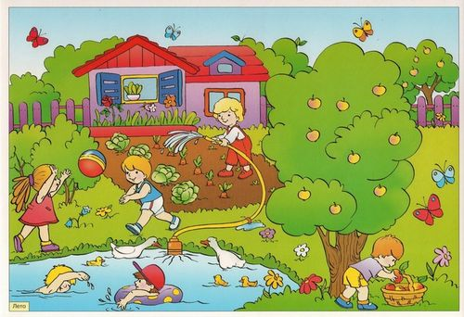
Hometask
Ex. 7, p. 87 (сост. свой диалог по примеру)
*Ex. 8, p. 87 (написать сообщение о погоде)

Slide 22
Thank you
for the lessons!!!

